Slide 1
SC-200T00A Microsoft Security Operations Analyst
Author name Date

Slide 2
Module 4: Create queries for Azure Sentinel using Kusto Query Language (KQL)

Slide 3
Module agenda
Construct KQL statements for Azure Sentinel
Analyze query results using KQL
Build multi-table statements using KQL
Work with string data in using KQL statements
Notes:
Important advice for teaching this module:
There are 4 lessons with KQL examples. You should type the KQL code (except larger examples) when demonstrating. You should demonstrate each KQL example. The learners will do a lab after each Lesson instead of at the end of the module. Make sure they type the command instead of copy and paste.

Slide 4
Lesson 1: Construct KQL statements for Azure Sentinel

Slide 5
Lesson introduction
After this lesson, you will be able to:
Construct KQL statements
Search log files for security events using KQL
Filter searches based on event time, severity, domain, and other relevant data using KQL

Slide 6
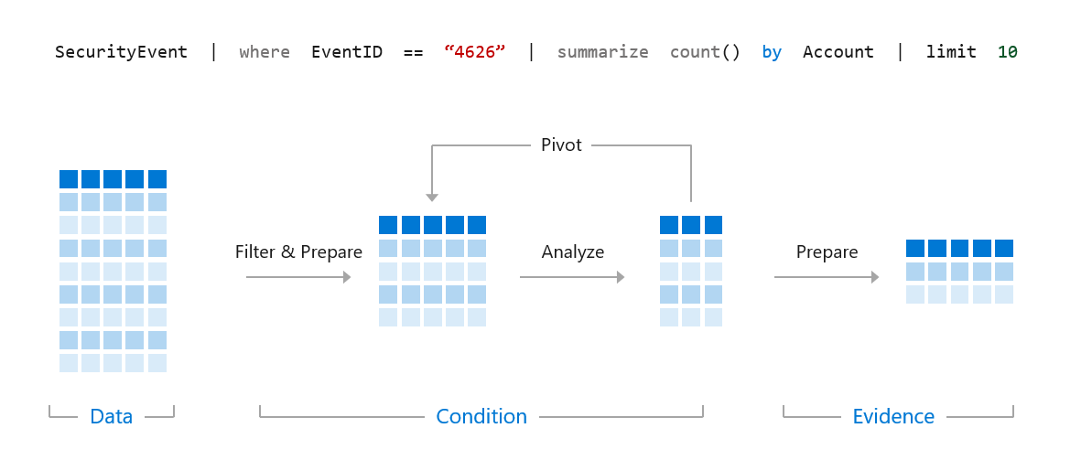
The Kusto Query Language statement structure
A KQL query is a read-only request to process data and return results. The request is stated in plain text, using a data-flow model designed to make the syntax easy to read, write, and automate.
Notes:
A KQL query is a read-only request to process data and return results. The request is stated in plain text, using a data-flow model designed to make the syntax easy to read, write, and automate. The query uses schema entities organized in a hierarchy similar to SQL's: databases, tables, and columns.
It is essential to understand how the results flow through the pipe "|". Everything on the left of the pipe is processed then passed to the right of the pipe.
Instructor demonstration:
Access the Log Analytics demo environment
Query Window

Slide 7
Use the let statement
let timeOffset = 7d;
let discardEventId = 4688;
SecurityEvent
| where TimeGenerated > ago(timeOffset*2) and TimeGenerated < ago(timeOffset)
| where EventID != discardEventId
let LowActivityAccounts =
SecurityEvent
| summarize cnt = count() by Account
| where cnt < 10;
LowActivityAccounts | where Account contains "Mal"
Notes:
Declare and reuse variables
Declare dynamic tables or lists

Slide 8
Use the search operator
search "err"
search in (SecurityEvent,SecurityAlert,A*) "err"

Slide 9
Use the where operator
SecurityEvent
| where TimeGenerated > ago(1d)
SecurityEvent
| where TimeGenerated > ago(1h) and EventID == "4624"
SecurityEvent
| where TimeGenerated > ago(1h)
| where EventID == 4624
| where AccountType =~ "user"
SecurityEvent | where EventID in (4624, 4625)

Slide 10
Use the extend operator
let timeframe = 1d;
let DomainList = dynamic(["tor2web.org", "tor2web.com"]);
Syslog
| where TimeGenerated >= ago(timeframe)
| where ProcessName contains "squid"
| extend
HTTP_Status_Code = extract("(TCP_(([A-Z]+)…-9]{3}))",8,SyslogMessage),
Domain = extract("(([A-Z]+ [a-z]{4…Z]+ )([^ :\\/]*))",3,SyslogMessage)
| where HTTP_Status_Code == "200"
| where Domain contains "."
| where Domain has_any (DomainList)
Notes:
Instructor: Demonstrate the extend operator
SecurityAlert
| where TimeGenerated > ago(7d)
| extend severityOrder = case (
AlertSeverity == "High", 3,
AlertSeverity == "Medium", 2,
AlertSeverity == "Low", 1,
AlertSeverity == "Informational", 0,
-1)

Slide 11
Use the order by operator
SecurityAlert
| where TimeGenerated > ago(7d)
| extend severityOrder = case (
AlertSeverity == "High", 3,
AlertSeverity == "Medium", 2,
AlertSeverity == "Low", 1,
AlertSeverity == "Informational", 0,
-1)
| order by severityOrder desc

Slide 12
Use the project operators
SecurityEvent
| project Computer, Account
SecurityAlert
| where TimeGenerated > ago(7d)
| extend severityOrder = case (
AlertSeverity == "High", 3,
AlertSeverity == "Medium", 2,
AlertSeverity == "Low", 1,
AlertSeverity == "Informational", 0,
-1)
| order by severityOrder
| project-away severityOrder
Operator | Description
project | Select the columns to include, rename or drop, and insert new computed columns.
project-away | Select what columns from the input to exclude from the output.
project-keep | Select what columns from the input to keep in the output.
project-rename | Select the columns to rename in the resulting output.
project-reorder | Set the column order in the resulting output.

Slide 13
Section break

Slide 14
Lesson 2: Analyze query results using KQL

Slide 15
Lesson introduction
After this lesson, you will be able to:
Summarize data using KQL statements
Render visualizations using KQL statements

Slide 16
Use the summarize operator
SecurityEvent
| summarize count() by Process, Computer
let timeframe = 1d;
SigninLogs
| where TimeGenerated >= ago(timeframe)
| where ResultType == "50057"
| where ResultDescription =~ "User account is disabled. The account has been disabled by an administrator."
| summarize applicationCount = dcount(AppDisplayName) by UserPrincipalName, IPAddress
| where applicationCount >= 3
Function(s) | Description
count(), countif() | Returns a count of the records per summarization group
dcount(), dcountif() | Returns an estimate for the number of distinct values taken by a scalar expression in the summary group.
avg(), avgif() | Calculates the average of Expr across the group.
Max(), maxif() | Returns the maximum value across the group.
sum(), sumif() | Calculates the sum of Expr across the group.

Slide 17
Use the summarize operator to filter results
SecurityEvent
| where Computer == "SQL12.NA.contosohotels.com"
| summarize arg_max(TimeGenerated,*) by Computer
SecurityEvent
| where Computer == "SQL12.NA.contosohotels.com"
| summarize arg_min(TimeGenerated,*) by Computer
Notes:
Instructor: Demonstrate
arg_max function
arg_min function
Revisiting the result pipe

Slide 18
Use the summarize operator to prepare data
SecurityEvent
| where EventID == "4624"
| summarize make_list(Account) by Computer
SecurityEvent
| where EventID == "4624"
| summarize make_set(Account) by Computer
Notes:
Instructor: Demonstrate
make_list() function
make_set() function

Slide 19
Use the render operator to create visualizations
SecurityEvent
| summarize count() by Account
| render barchart
SecurityEvent
| summarize count() by bin(TimeGenerated, 1d)
| render timechart
Visualizations
areachart
barchart
columnchart
piechart
scatterchart
timechart
Notes:
Instructor: Demonstrate
render operator

Slide 20
Section break

Slide 21
Lesson 3: Build multi-table statements using KQL

Slide 22
Lesson introduction
After this lesson, you will be able to:
Create queries using unions to merge results from multiple tables using KQL
Merge two tables with the join operator using KQL

Slide 23
Use the union operator
SecurityEvent
| union SecurityAlert
union Security*
| summarize count() by Type
Notes:
Instructor: Demonstrate
union operator

Slide 24
Use the join operator
SecurityEvent
| where EventID == "4624"
| summarize LogOnCount=count() by EventID, Account
| project LogOnCount, Account
| join kind = inner (
SecurityEvent
| where EventID == "4634"
| summarize LogOffCount=count() by EventID, Account
| project LogOffCount, Account
) on Account
Notes:
Instructor: Demonstrate
join operator

Slide 25
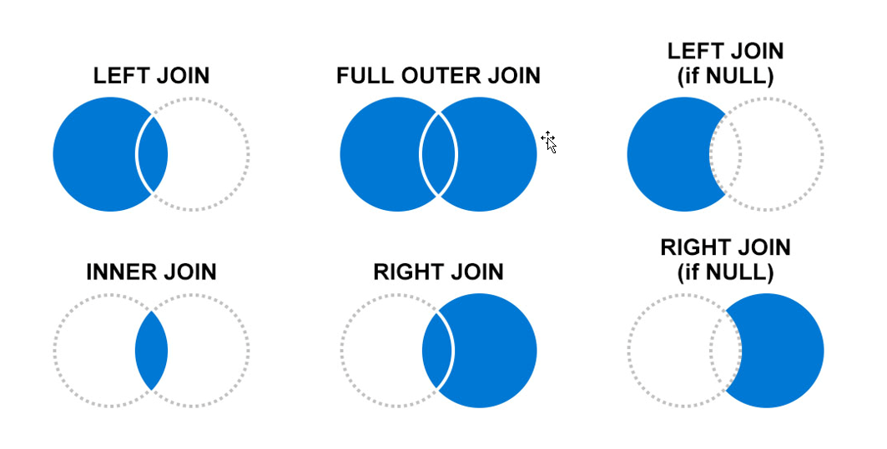
Use the join operator (continued)
When joining tables, you use Join flavors to determine the joining behavior. It is essential to understand the impact of records on the left and right side based on the join flavor.

Slide 26
Section break

Slide 27
Lesson 4: Work with string data using KQL statements

Slide 28
Lesson introduction
After this lesson, you will be able to:
Extract data from unstructured string fields using KQL
Extract data from structured string data using KQL
Create Functions using KQL

Slide 29
Extract data from unstructured string fields
Extract function:
let top5 = SecurityEvent
| where EventID == 4625 and AccountType == 'User'
| extend Account_Name = extract(@"^(.*\\)?([^@]*)(@.*)?$", 2, tolower(Account))
| summarize Attempts = count() by Account_Name
| where Account_Name != ""
| top 5 by Attempts
| summarize make_list(Account_Name);
SecurityEvent
| where EventID == 4625 and AccountType == 'User'
| extend Name = extract(@"^(.*\\)?([^@]*)(@.*)?$", 2, tolower(Account))
| extend Account_Name = iff(Name in (top5), Name, "Other")
| where Account_Name != ""
| summarize Attempts = count() by Account_Name

Slide 30
Extract data from unstructured string fields (continued)
Parse function:
Event
| where RenderedDescription !has "LGIS" and RenderedDescription !has "LGIF"
| parse RenderedDescription with * "action_id:" Action:string
" " *
| parse RenderedDescription with * "client_ip:" ClientIP:string
" permission" *
| parse RenderedDescription with * "session_server_principal_name:" CurrentUser:string
" " *
| parse RenderedDescription with * "database_name:" DatabaseName:string
"schema_name:" Temp:string
"object_name:" ObjectName:string
"statement:" Statement:string
"." *
Notes:
Instructor: Demonstrate
extract function
parse function

Slide 31
Extract data from structured string data
Parse dynamic fields:
AzureActivity
| project Properties_d.eventCategory
Work with JSON data:
SecurityAlert
| extend ExtendedProperties = todynamic(ExtendedProperties)
| extend ActionTaken = ExtendedProperties.ActionTaken
| extend AttackerIP = ExtendedProperties["Attacker IP"]
Notes:
Instructor: Demonstrate
dynamic fields
JSON data

Slide 32
Integrate external data
Users
| where UserID in ((externaldata (UserID:string) [
@"https://storageaccount.blob.core.windows.net/storagecontainer/users.txt"
h@"?...SAS..." // Secret token needed to access the blob
]))
| ...

Slide 33
Create Parsers using functions
OfficeActivity
| where TimeGenerated >= ago(30d)
| where Operation == 'New-InboxRule’
// Save the query as a function named MailboxForward
MailboxForward
Notes:
Instructor: Demonstrate
functions

Slide 34
Section break

Slide 35
Knowledge check
Check your knowledge with the module quiz in your course viewer

Slide 36
Lab 01 – Create queries for Azure Sentinel using Kusto Query Language (KQL)

Slide 37
Lab Exercises
1
Create queries for Azure Sentinel using Kusto Query Language (KQL)

Slide 38
Closing slide

